Slide 1

AgriSphere – Intelligent Digital Agriculture Ecosystem
CSA0904-Programming in Java
Presented By
MOHAN RAJ VD(192424151) MONESH S(192324027) DHARSHAN AN(192525370) SELVA PRABHU AK(192421244) GANESH P(192421142
Supervised By
Dr.R.Thalapathi Rajasekaran`
SIMATS Engineering

Slide 2


Introduction
AgriSphere is an intelligent digital agriculture ecosystem that connects farmers, buyers, and service providers on a single platform.
The platform enables farmers to create digital profiles and manage their agricultural products efficiently.
Buyers can easily search, compare, and purchase agricultural products from trusted farmers.
AI technology provides personalized recommendations based on user preferences and market trends.
Smart notifications keep users informed about orders, payments, and important agricultural updates.
Analytics dashboards help users monitor business performance and make informed decisions.
The project promotes digital transformation by making agriculture smarter, faster, and more efficient.

Slide 3
PROBLEM STATEMENT
Farmers often struggle to find genuine buyers and receive fair prices for their products.
Buyers face difficulty in identifying trusted farmers and quality agricultural products.
Agricultural services such as equipment rental and consultancy are not available on a single platform.
Traditional farming and selling methods reduce efficiency and increase operational costs.
Farmers have limited access to AI-based recommendations and real-time market insights.
Existing agriculture applications do not provide complete digital solutions for all stakeholders.
A centralized digital ecosystem is required to improve communication, sales, and agricultural productivity.

Slide 4
Project Scope & Objectives
Developed a centralized platform that connects farmers, buyers, service providers, and administrators.
Allow farmers to manage products, receive orders, and track their sales digitally.
Provide buyers with a secure marketplace to purchase agricultural products.
Integrate AI to deliver personalized recommendations and market insights.
Implemented smart notifications for orders, payments, and important updates.
Generated analytics reports to help users monitor performance and business growth.
Built a scalable system that can support future technologies like IoT and weather forecasting.

Slide 5


LITERATURE REVIEW
S. No | LITERATURE TITLE | AUTHOR AND YEAR | LIMITATIONS | HOW OUR PROJECT OVERCOMES IT
1 | Smart Agriculture Monitoring Using IoT and Cloud Computing | Patel & Singh, 2022 | Focuses only on farm monitoring and sensor data without providing an online marketplace. | Integrates smart farming with an AI-powered marketplace connecting farmers, buyers, and service providers.
2 | AI-Based Crop Recommendation and Yield Prediction System | Kumar et al., 2023 | Provides crop recommendations but does not support product selling or business management. | Combines AI recommendations with product management, buyer discovery, and business analytics.
3 | Online Agricultural Marketplace for Farmers | Sharma & Verma, 2021 | Supports online product selling but lacks AI recommendations and service provider integration. | Offers AI-based recommendations, service booking, smart notifications, and a complete digital agriculture ecosystem.
4 | Digital Farming Platform with Precision Agriculture | Das & Roy, 2024 | Concentrates on precision farming techniques without connecting buyers and agricultural services. | Connects farmers, buyers, and service providers while providing analytics, AI insights, and an integrated marketplace.

Slide 6
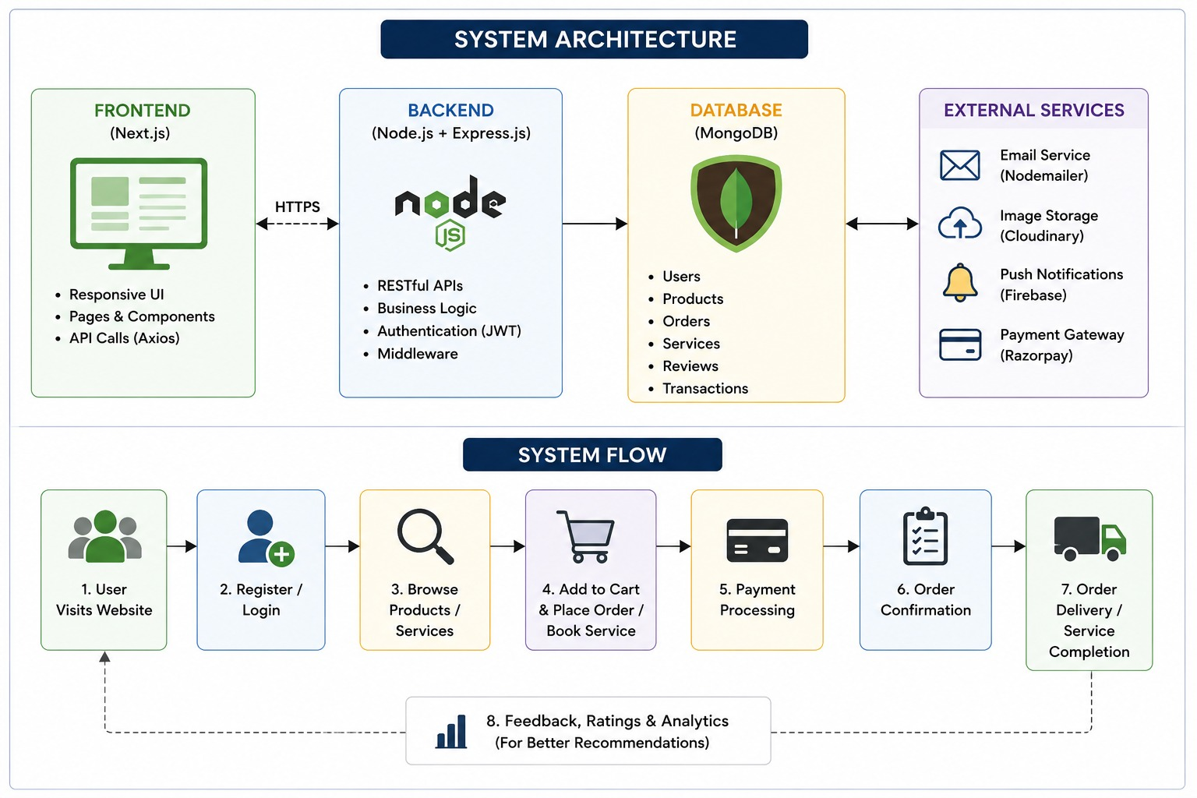
System Architecture
.

Slide 7
MODULES
Module 1 – User & Profile Management
Provides secure registration, login, and role-based access for farmers, buyers, service providers, and administrators. Users can create and manage their profiles within the platform.
Module 2 – Smart Digital Marketplace
Enables farmers to list agricultural products while buyers can search, compare, and purchase them through an easy-to-use online marketplace.
Module 3 – AI Recommendation Engine
Uses user preferences and browsing history to provide personalized product recommendations, improving product discovery and customer experience.
Module 4 – Order & Service Management
Handles shopping cart operations, order placement, payment processing, service bookings, and real-time order tracking for users.
Module 5 – Analytics & Administration
Provides administrators with dashboards to monitor users, products, orders, and sales while generating reports and business insights for better decision-making.
.

Slide 8
Module 1 – User & Profile Management
Provides secure registration and login functionality for farmers, buyers, service providers, and administrators, with different access permissions based on the user's role.
Allows farmers and service providers to create and maintain digital profiles containing their relevant details, enabling buyers to identify and connect with trusted users.
Implements role-based access control so that each type of user can access only the features and operations relevant to their responsibilities.
Enables users to manage their account information while maintaining secure authentication and controlled access to marketplace, services, orders, and administrative features.
Creates the basic user-management layer that connects all stakeholders within the centralized AgriSphere AI digital agriculture ecosystem.
.

Slide 9
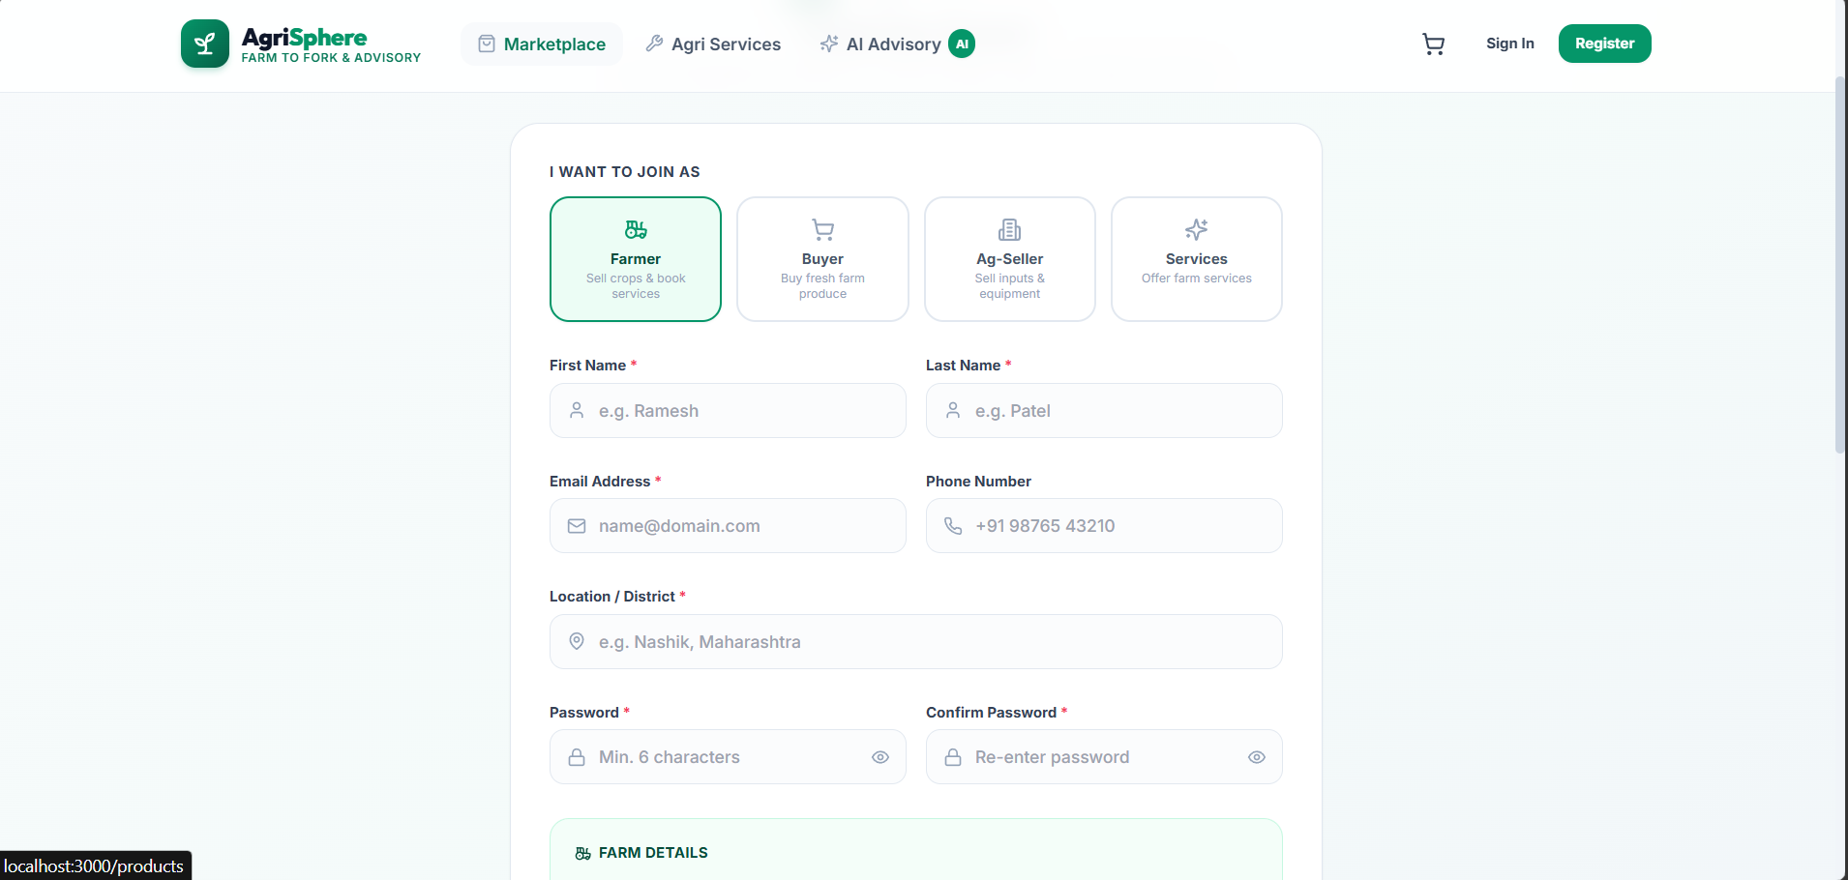
SAMPLE OUTPUT
.

Slide 10
Module 2 – Smart Digital Marketplace
Provides farmers with a digital marketplace where they can list, manage, and sell agricultural products directly to potential buyers without depending entirely on traditional selling methods.
Allows buyers to browse, search, and compare agricultural products based on the available product information before making purchasing decisions.
Creates a direct connection between farmers and genuine buyers, helping farmers improve product reach while allowing buyers to access products from trusted agricultural sources.
Integrates product discovery and purchasing into a single online platform, reducing the difficulty of finding agricultural products and improving the overall buying and selling process.
Supports the project's objective of creating a centralized marketplace that combines agricultural product management, buyer discovery, and digital sales within the same ecosystem.
.

Slide 11
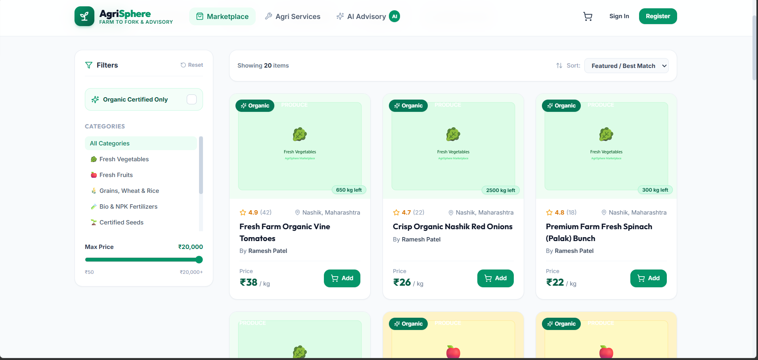
SAMPLE OUTPUT
\
.

Slide 12
Module 3 – AI Recommendation Engine
Uses user preferences and browsing behaviour to understand the interests of buyers and generate personalized agricultural product recommendations.
Analyzes user interaction with available products to improve product discovery, helping users find relevant products instead of manually searching through the entire marketplace.
Provides AI-based recommendations that can support users in making better farming and business decisions based on their requirements and available marketplace information.
Integrates AI capabilities with the marketplace so that recommendations are not isolated features but directly contribute to product discovery and customer experience.
Extends the platform beyond a traditional agricultural marketplace by combining AI recommendations, marketplace data, and business insights in one digital ecosystem.
.

Slide 13
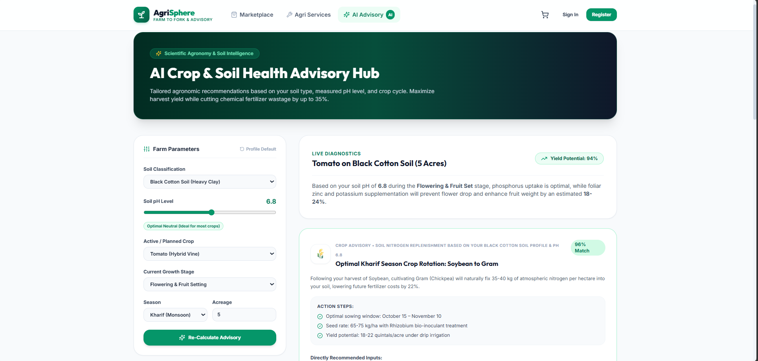
Sample Output
.

Slide 14
Module 4 – Order & Service Management
Manages the complete transaction flow from adding products to the shopping cart and placing an order to payment processing and order confirmation.
Provides support for agricultural service bookings, allowing users to access services offered by service providers through the same centralized platform.
Maintains order status and provides real-time tracking, helping users monitor the progress of their purchases and reducing uncertainty during delivery.
Integrates payment processing with order management so that transactions, confirmations, and related notifications can be handled as part of the same workflow.
Supports smart notifications for orders, payments, and important transaction updates, improving communication between users and reducing delays in the overall process.
.

Slide 15
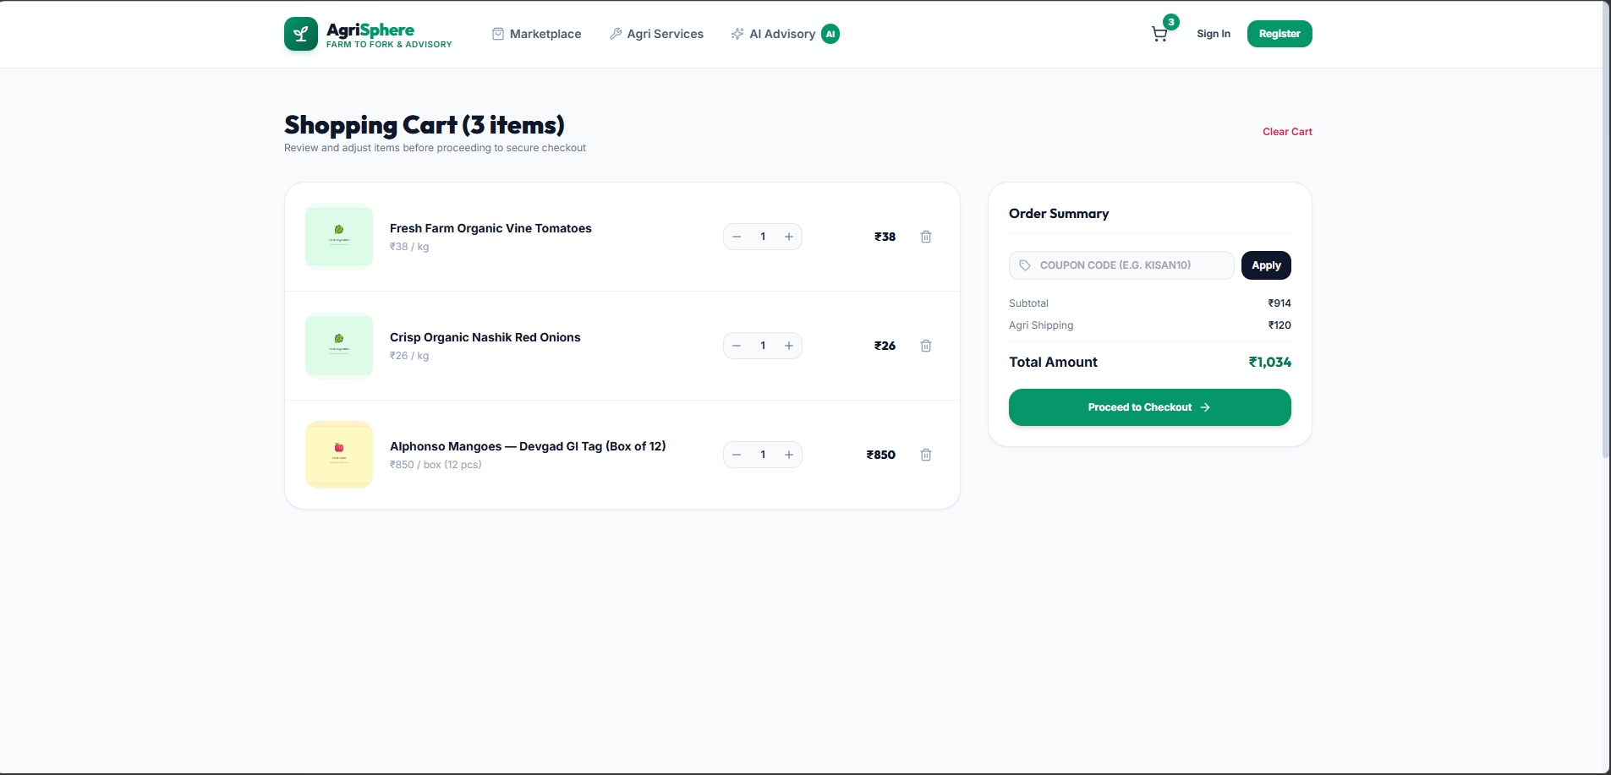
SAMPLE OUTPUT
.

Slide 16
Module 5 – Analytics & Administration
Provides administrators with centralized dashboards to monitor registered users, agricultural products, orders, transactions, and overall sales activity across the platform.
Generates analytical reports that help administrators understand business performance, sales trends, user activity, and platform operations for better decision-making.
Enables monitoring of the marketplace and its different stakeholders, helping administrators maintain the reliability, security, and efficient operation of the digital ecosystem.
Uses collected platform data to provide business insights and performance analysis, supporting farmers and administrators in understanding growth and transaction patterns.
Provides the management and analytics layer required to make AgriSphere AI a scalable digital agriculture platform rather than only an online product-selling application.
.

Slide 17
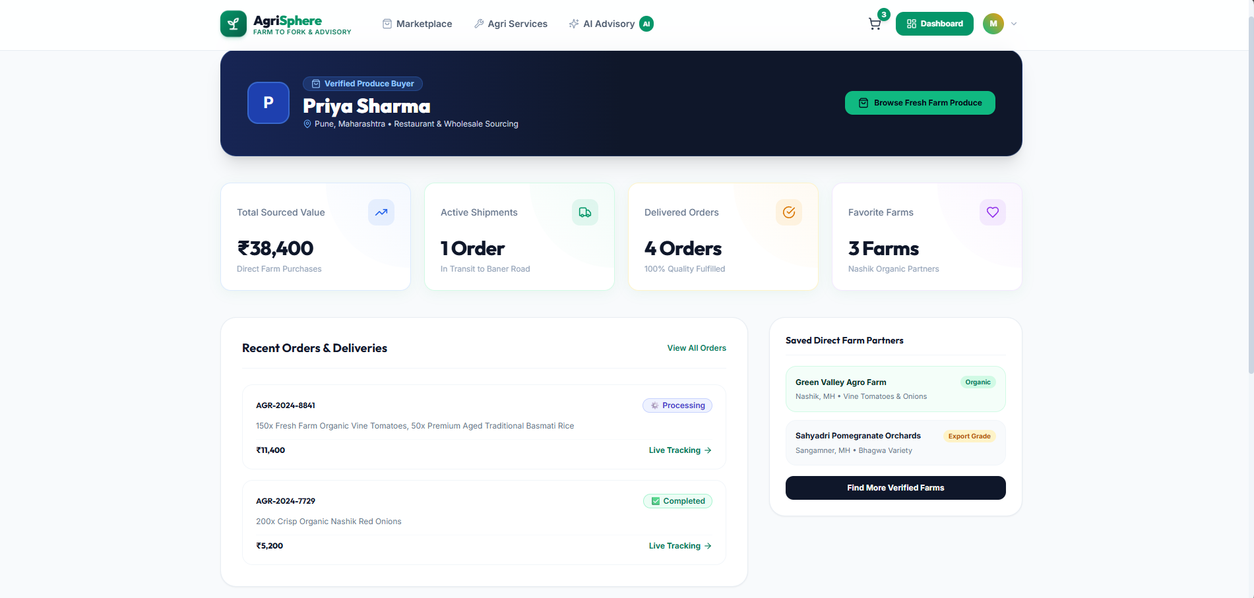
SAMPLE OUTPUT
.

Slide 18
Result and Outcome
Farmers can directly connect with buyers through the digital marketplace, providing better access to customers and supporting increased income through digital product sales.
Buyers can search, compare, and purchase agricultural products from trusted farmers through a centralized platform, making the overall buying process easier and more efficient.
Service providers can offer services through the same platform, creating a common digital ecosystem where users can access agricultural products as well as related services.
The AI recommendation engine provides personalized product recommendations based on user preferences and interactions, helping users discover relevant products and make better farming and business decisions.
The project brings farmers, buyers, service providers, and administrators together on a single platform, promoting a smarter, more efficient, and technology-driven agricultural ecosystem.

Slide 19
Future Scope and recommendations
IoT-Based Smart Farming: Integrate IoT sensors to collect real-time data such as soil moisture, temperature, humidity, and crop conditions, enabling smarter farm monitoring.
Advanced AI Recommendations: Enhance the AI system to provide more advanced recommendations for crops, products, farming activities, and market decisions using larger amounts of user and agricultural data.
Real-Time Market Insights: Integrate live agricultural market data to provide farmers with current price trends and demand information, helping them decide when and where to sell their products.
Advanced Predictive Analytics: Extend the analytics module with predictive models for sales, demand, product trends, and business growth to support proactive decision-making.
Mobile Application Development: Extend the platform into dedicated mobile applications so farmers, buyers, and service providers can access marketplace, orders, services, and notifications conveniently from mobile devices.

Slide 20
Conclusion
AgriSphere AI is a complete digital agriculture ecosystem.
It connects farmers, buyers, and service providers in one platform.
AI improves efficiency through smart recommendations and analytics.
The marketplace simplifies agricultural buying and selling.
Multiple user roles make the system flexible and scalable.
The project supports future expansion with advanced AI features.
AgriSphere AI contributes to modern, smart, and sustainable agriculture.

Slide 21
Thank You!

